Slide 1

Holmer Green Senior School
Year 7 Parent Information Evening

Slide 2

Mission: To help students become the best possible versions of themselves they can be.
Motto - ‘Work Hard, Be Kind & Have Passion’
Core Values:
Work Hard
Be Kind
Have Passion
Excellence
Curiosity

Slide 3
Introductions
Headteacher - Ed Hillyard
Head of Year 7 – Peyton Owings
Pastoral Manager – Charlotte Hemming / Rachel Brooks
Deputy Headteacher – Laura Foster
SENDCo – Sarah Wilson

Slide 4
Agenda for the evening
Introduction to Holmer Green Senior School
Key Information
Opportunity to meet your child’s Form Tutor

Slide 5
Curriculum
Subjects plan and deliver ambitious, well-sequenced seven-year curriculum. The knowledge and vocabulary to be learned is specified
Year 9 students select three specialism subjects to focus on
(Visual Arts, Expressive Arts, Design Technology)
Year 10 students select three GCSE options to complement our core offer
Year 12 students select 3 or 4 A-Level/Vocational qualifications

Slide 6
Reporting
Online booking system for Parents’ Evenings – 11th June
Attitude to learning (ATL) report each half term, graded 1-4 (1 being the best)
% score report sent out twice a year – February and July
Targets based on KS2 data for all subjects – it is an indication of how well a child may do
9-1 grading system and fine grades Low/Middle/High

Slide 7
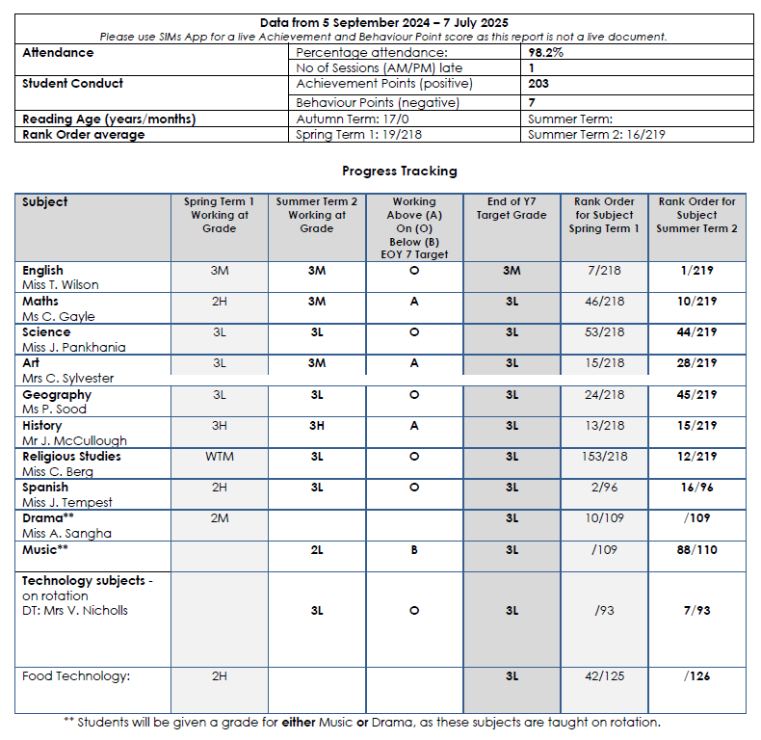
Reporting

Slide 9
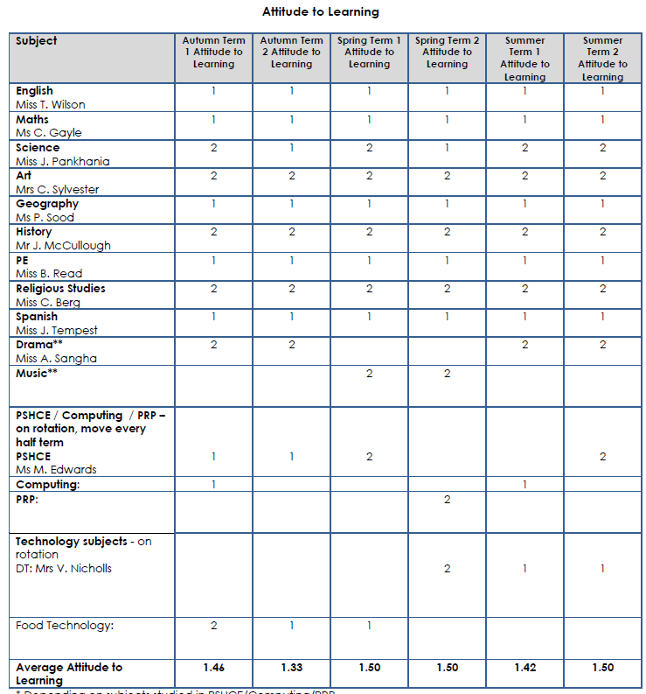

Slide 11
Homework
Monday​ | Tuesday​ | Wednesday​ | Thursday​ | Friday​
History​ Biology​ | Chemistry​ English​ ​ | Geography​ RS​ ​ ​ | MFL​ Physics​ | Maths- online​ Dr Frost​ Music/Drama​
1 hour​ | 1 hour​ | 1 hour​ | 1 hour​ | 1 hour​
Food: ingredients list.​ DT and Art: Ongoing project work.​
Reading for Pleasure- 1 hour per week recorded as per English dept directive​
Total: 6 hours per week​

Slide 12


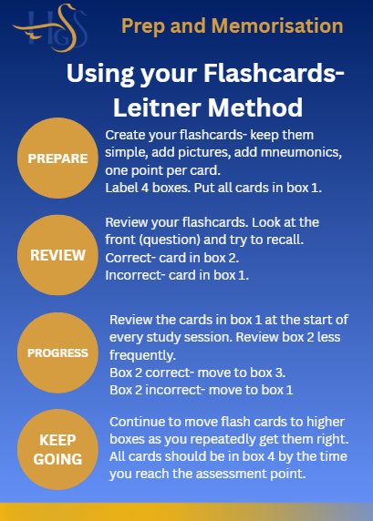
Prep and Memorisation
Core knowledge acquisition is essential for students to make progress in a subject. Students need to be able to access knowledge readily and easily and therefore they need retrieval practice on a regular basis.

Slide 13
Attendance and Punctuality
Attendance over One School Year
If a student had:
95% attendance = 10 days absent from school (50 hours of learning to catch up)
90% attendance = 4 weeks absent from school (100 hours of learning to catch up)
Attendance over 5 year (Years 7-11) …
If a student had:
90% attendance = having about half a year off school!
80% attendance = 38 weeks off school = one whole school year missed!

Slide 14
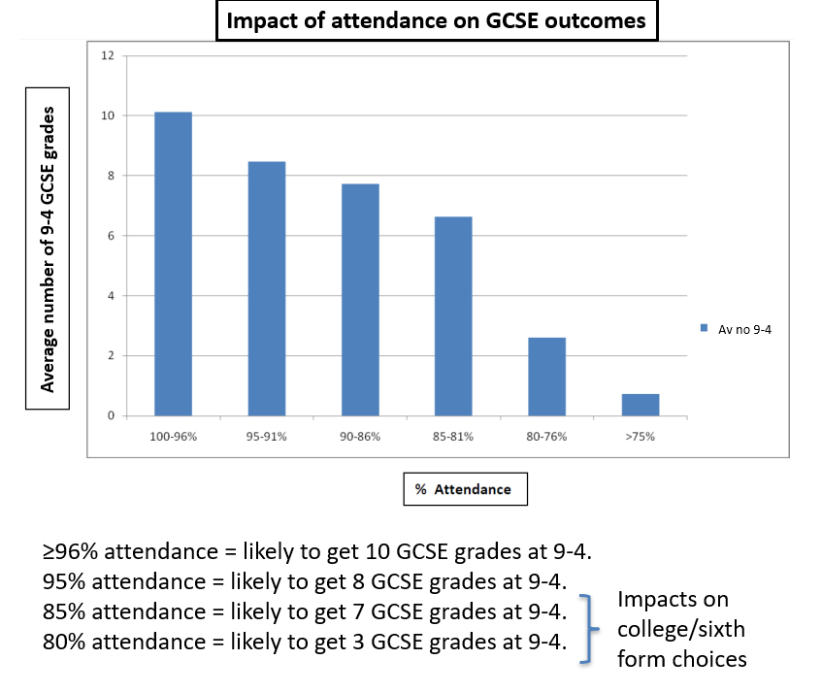
Attendance and Punctuality

Slide 15
Head Of Year
Miss Owings
Head of Year 7
owingsp@holmer.org.uk

Slide 16
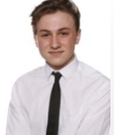
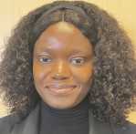
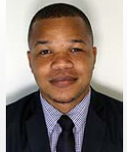
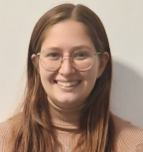
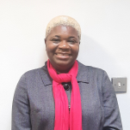
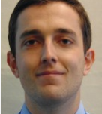

Form Tutors
Mr Travell
TravellJ@holmer.org.uk
Mrs McKnight
McknightC@holmer.org.uk
Ms Nnaji
NnajiS@holmer.org.uk
Mr Johnson
JohnsonA@holmer.org.uk
Miss Pankhania
PankhaniaJ@holmer.org.uk
Mrs Clarke-James
ClarkeJamesO@holmer.org.uk
Mr Larkin
LarkinH@holmer.org.uk

Slide 17
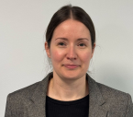
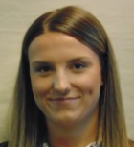
Pastoral Support
Mrs Foster
Deputy Headteacher Behaviour and Pastoral FosterL@holmer.org.uk
Miss Hemming
Pastoral Manager
HemmingC@holmer.org.uk

Slide 18

How your child might be feeling…

Slide 19
Thank you

